Slide 1
Data Encryption Standard (DES)

Slide 2
Cryptology
Cryptography
Symmetric Ciphers
Asymmetric Ciphers
Cryptanalysis
Protocols
Block Ciphers
Stream Ciphers
Integer Factoring Problem
Discrete Logarithm problem
AES
DES

Slide 3
Introduction

Slide 4
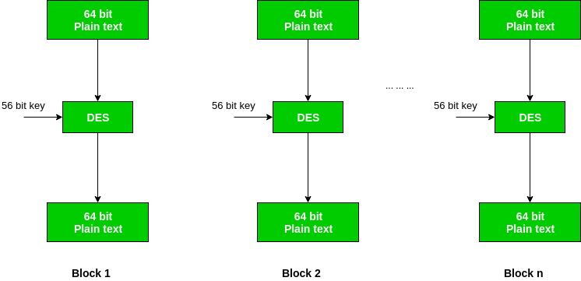
https://www.geeksforgeeks.org/computer-network-data-encryption-standard-des-set-1/

Slide 5
Facts
Developed by IBM under influence of the National Security Agency (NSA)
Most popular block cipher for most of the last 30 years
Insecure due to the small key length of 56 bit
Replaced by the Advanced Encryption Standard

Slide 6
High level view

Slide 7
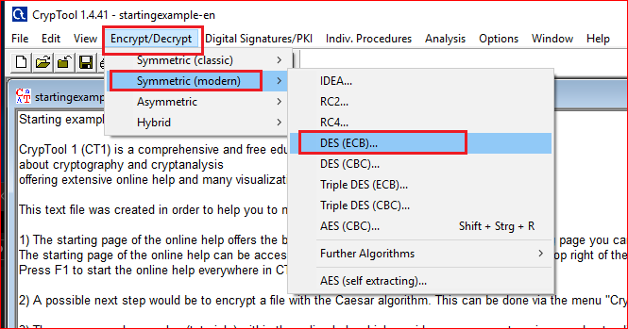

Slide 8
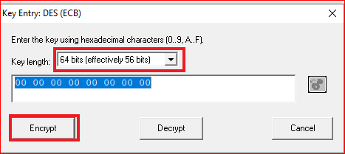
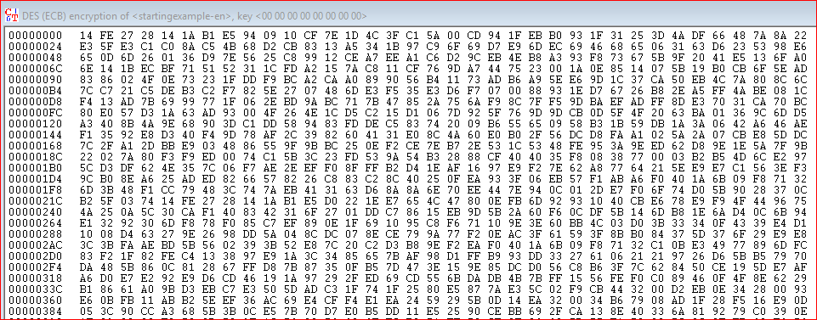

Slide 9
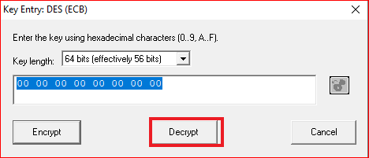
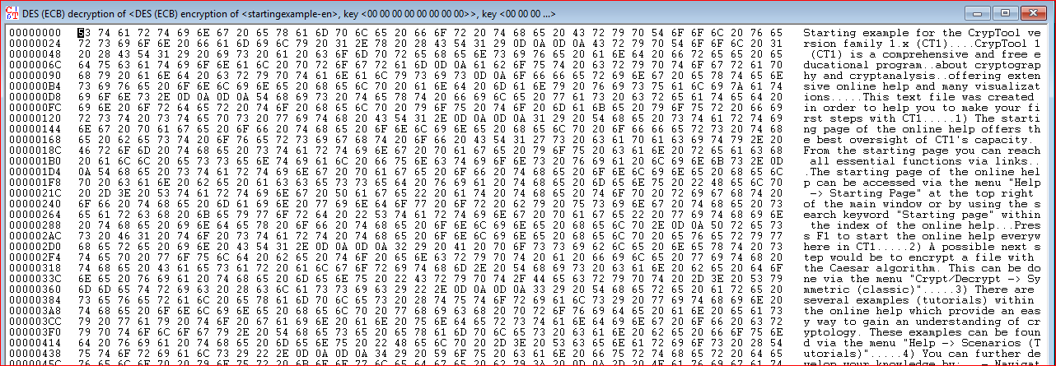

Slide 10
DES Internal Structure

Slide 11
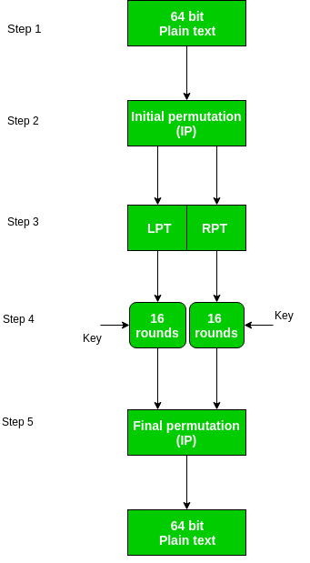
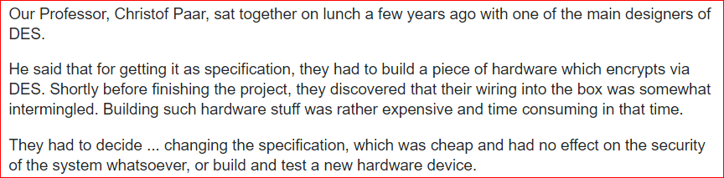
No influence
https://crypto.stackexchange.com/questions/3/what-are-the-benefits-of-the-two-permutation-tables-in-des
Confusion and Diffusion

Slide 12
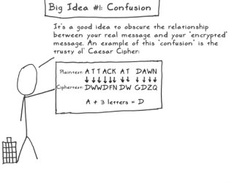
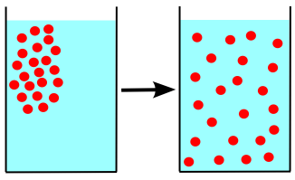
Block Cipher Primitives: Confusion and Diffusion
Confusion: An encryption operation where the relationship between key and ciphertext is obscured.
substitution
Diffusion: An encryption operation where the influence of one plaintext symbol is spread over many ciphertext symbols with the goal of hiding statistical properties of the plaintext.
against frequency attacks

Slide 13
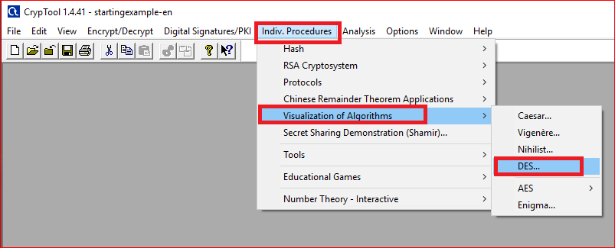

Slide 14
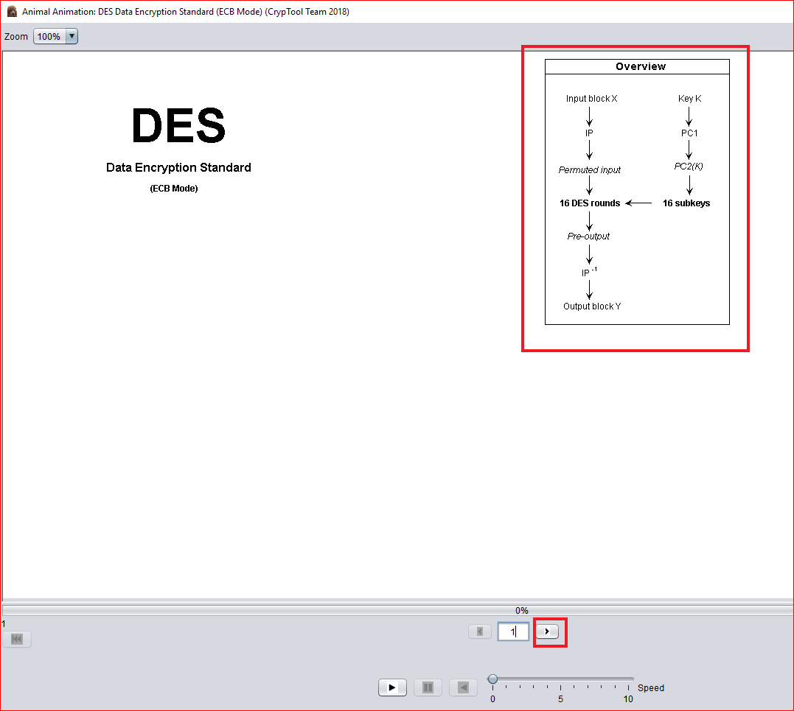

Slide 15
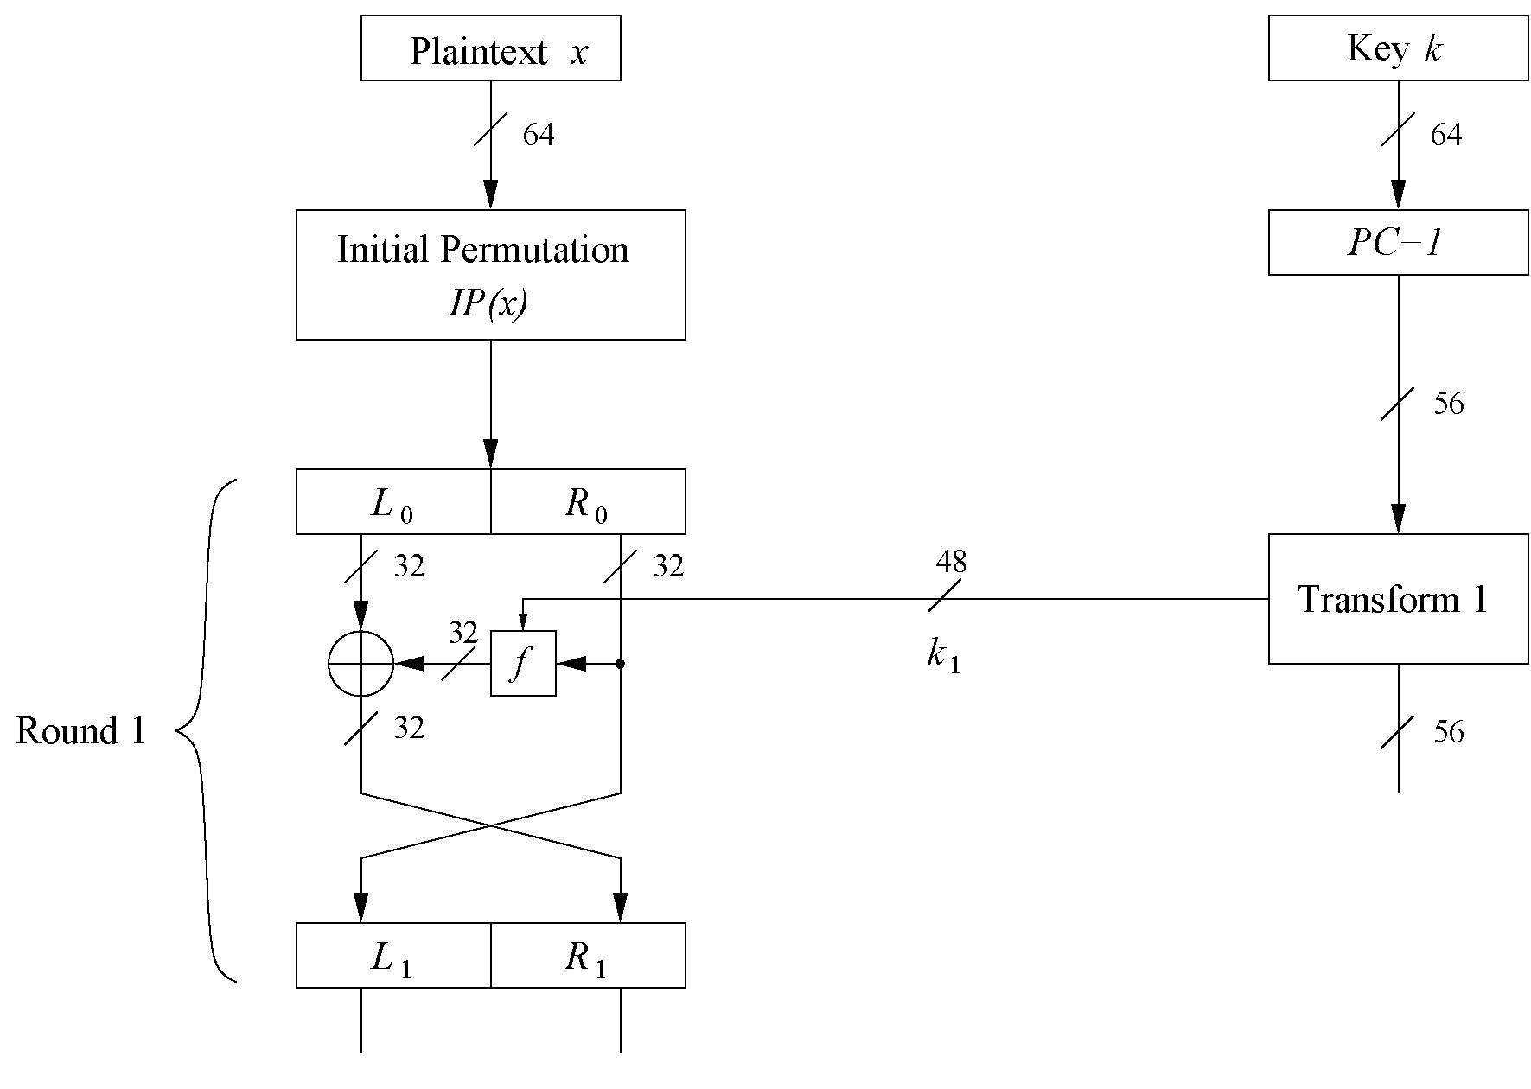

Slide 16
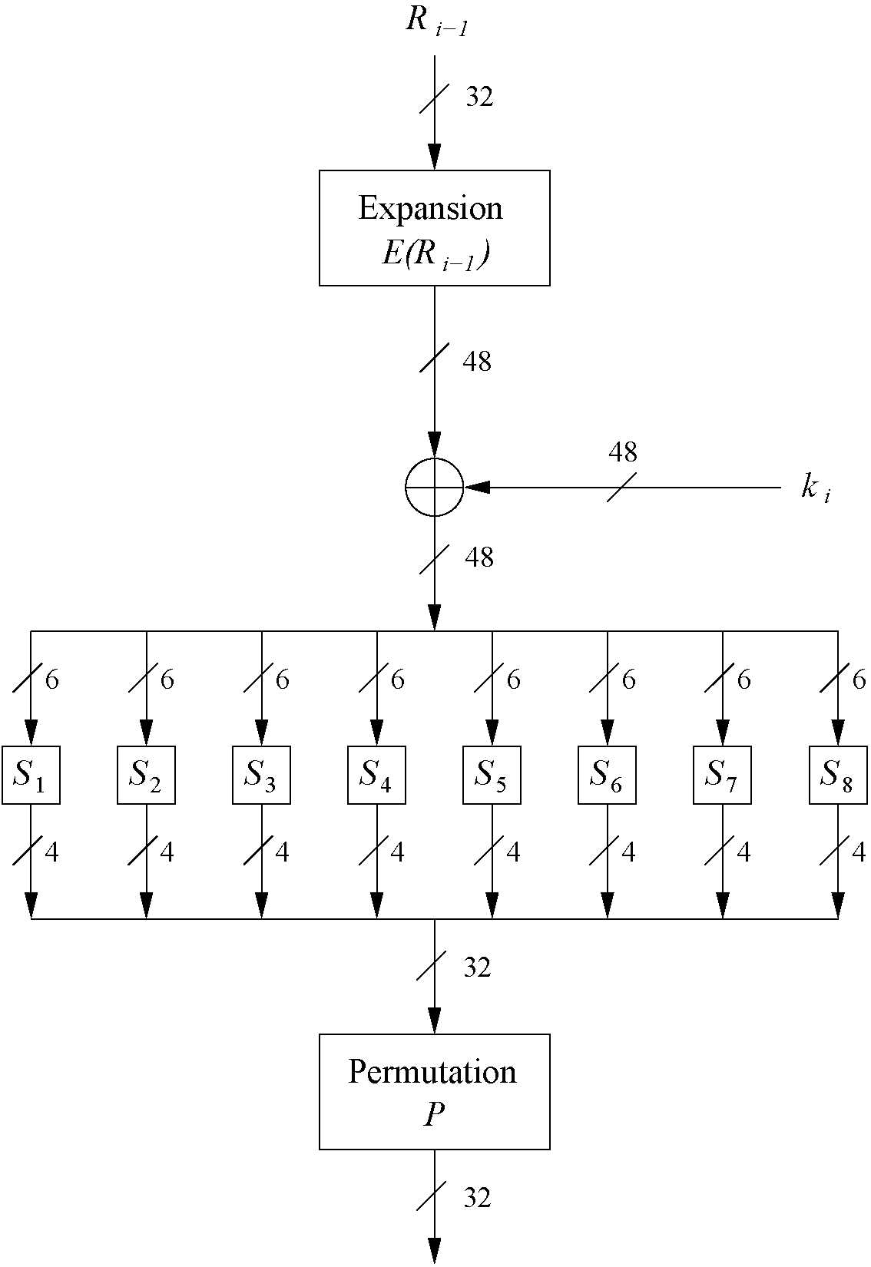
The f-Function
main operation of DES
f-Function inputs: R_{i-1} and round key k_{i}
4 Steps:
Expansion E
XOR with round key
S-box substitution
Permutation

Slide 17
Question
All inputs are “0”, what is the output of the first around?

